Slide 1
Augmenting System Tests with Component Tests for Reliability Assurance
Joint work with Jace Ritchie and
Mike Hamada

Slide 2
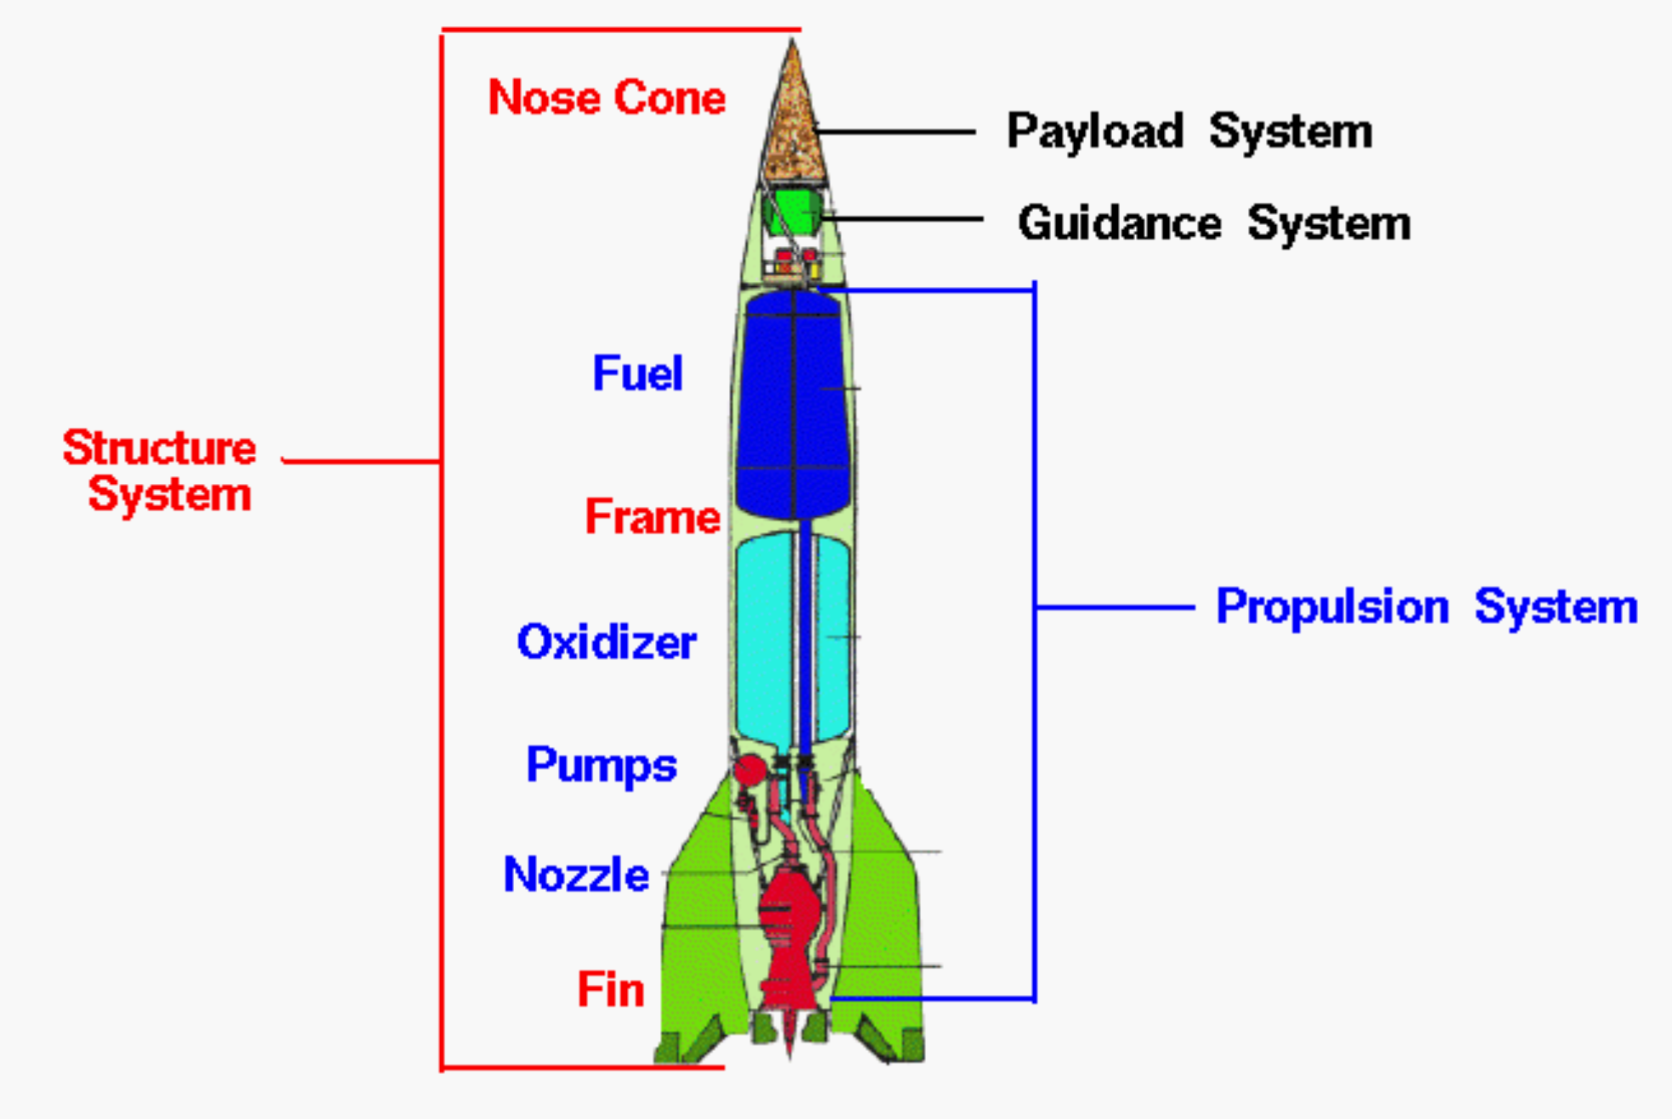
Overview
The reliability of products is of great interest to both manufacturers and customers
Testing can be expensive!
Our approach can reduce testing costs by replacing some system tests with component tests

Slide 3

Background
Definition of an assurance test
Test plans consist of the number of required tests (n) and the number of acceptable failures (c) to pass the test.
Can control for two possible errors
Consumer’s risk
Producer’s risk
Define acceptable and rejectable reliability levels

Slide 4
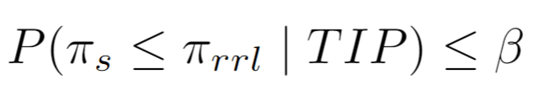
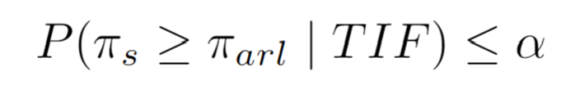
Bayesian Assurance Testing
Straightforward to incorporate prior knowledge through priors
Condition on two possible outcomes
Test is passed (TIP)
Test is failed (TIF)
Posterior risks are defined in terms of posterior probabilities
Acceptable posterior consumer’s risk (PCR) is defined to be:
Acceptable posterior producer’s risk (PPR) is defined to be:

Slide 5
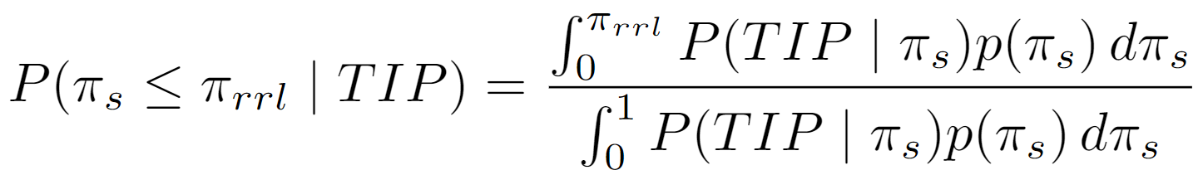
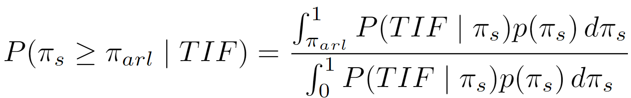
Consumer’s and Producer’s Risks
Both customers and manufacturers want the product to work well
Consumers want the posterior probability that the reliability is no more than a specified rejectable reliability level (π_{rrl}) given the assurance test is passed to be low
Producers want the posterior probability that the reliability is at least a specified acceptable reliability level (π_{arl}) given the assurance test is failed to be low

Slide 6

Defining a Test Plan
A test plan is composed of two elements:
The total number of assurance tests applied to the system or component (n)
The number of acceptable system failures (c)
When a product has high reliability:
PCR tends to be low when c is low and n is high
PPR tends to be low when c is high and n is low
An acceptable test plan has PCR and PPR lower than some thresholds (β and α, respectively)
In some situations, the choice is made not to control PPR

Slide 7
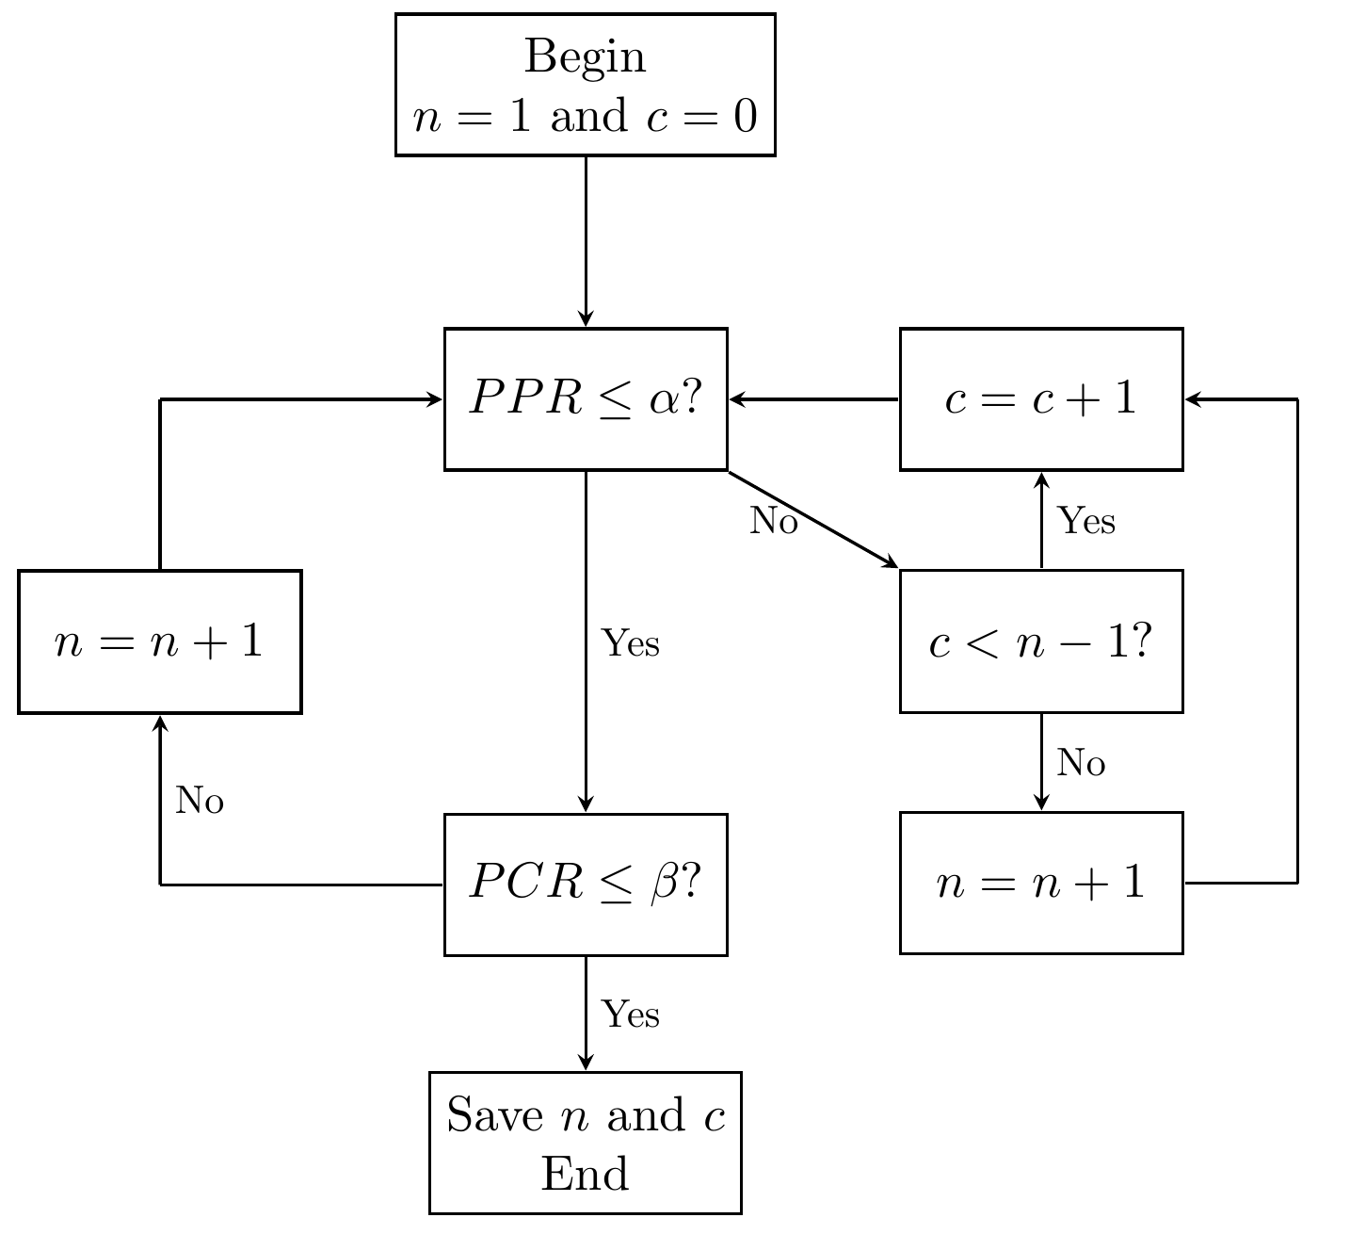
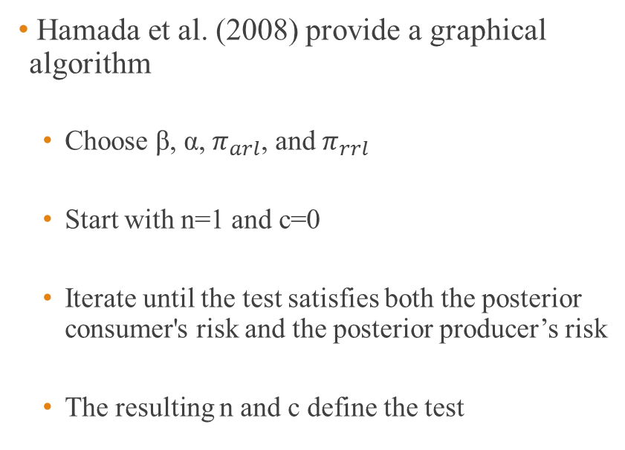
How to find a Bayesian assurance test
Hamada et al. (2008) provide a graphical algorithm
Choose β, α, $π_{arl}$, and $π_{rrl}$
Start with n=1 and c=0
Iterate until the test satisfies both the posterior consumer's risk and the posterior producer’s risk
The resulting n and c define the test

Slide 8

What is a system?
A group of component parts and/or subsystems
Can be arbitrarily large and complex
We assume independence of components, the probability of a system failure can be modeled using basic statistical methods
In this work we only consider one-shot systems with either pass or fail a test

Slide 9
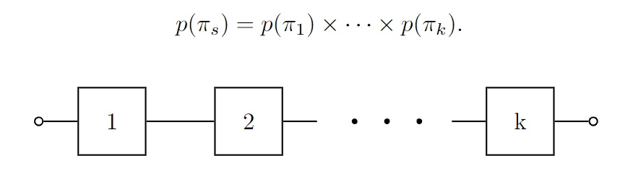
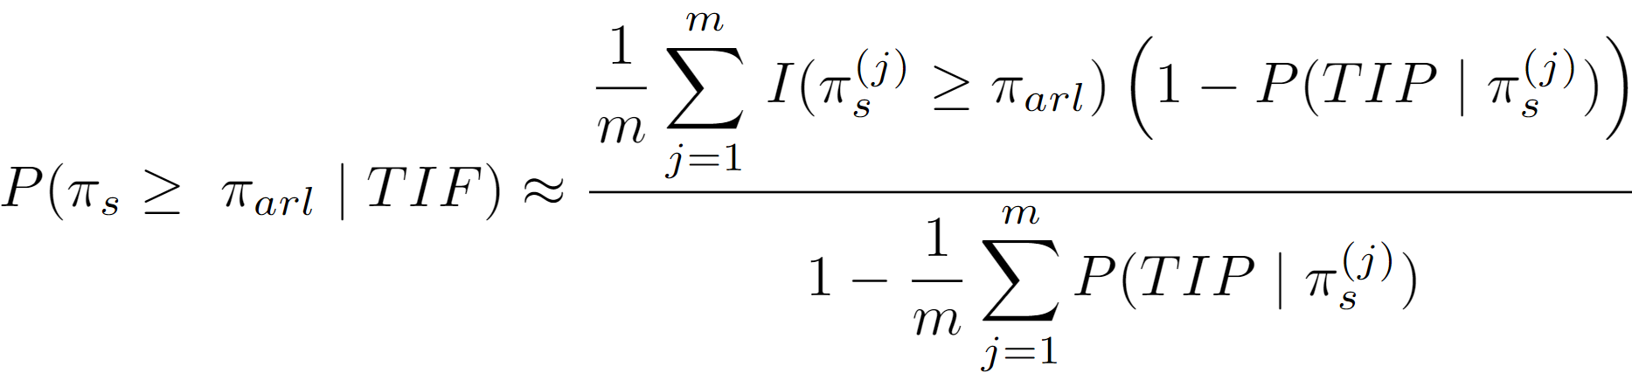
Series Systems
The system fails when a single component fails
Under independence assumptions, its reliability is easily calculated
PPR and PCR are hard to calculate for large systems
We calculate PCR and PPR via Monte Carlo integration

Slide 10
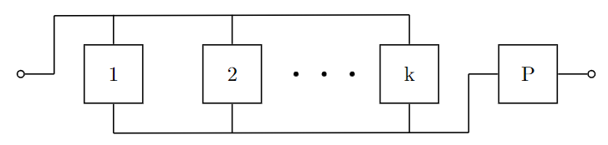
Parallel Systems
The system fails when every single component fails
Under independence assumptions, its reliability is easily calculated
PPR and PCR are hard to calculate for large systems
We calculate PCR and PPR via Monte Carlo integration

Slide 11
Previous Work
Hamada et al. (2008, 2014) consider consumer’s and producer’s risks based assurance tests
Hamada et al. (2008, 2014), Ten and Xie (1998), and Guo et al. (2010) use beta distributions as prior distributions, but only consider PCR
Smith et al. (2010) considers zero-failure component assurance tests as well as maximizing posterior reliability under cost restraints

Slide 12
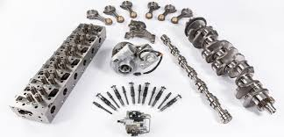
Proposed Method
Allow component tests to be used directly in assurance tests
Now an assurance test plan consists of an “n” and a “c” for the system and each component (including subsystems)
Finding an assurance test plan is no longer a trivial exercise
Could result in large savings
Strong assumptions could lead to problems

Slide 13
Assumptions
The system must be represented as a reliability block diagram
Components fail independent of each other
Components should be testable and have prior probability of failure
The cost of each component and system tests are known

Slide 14



Phantom Components
What happens when the series isn’t a perfect series? Or when the parallel assumption doesn’t work?
Graves et. al. (2010) proposed using one or more latent components to approximate a series or parallel system
We relax the by adding a “phantom” (or latent) component
Can’t be tested
Very dependent on its prior
We generally assume violations of the series, parallel, or independence assumptions result in a smaller π_{s}

Slide 15
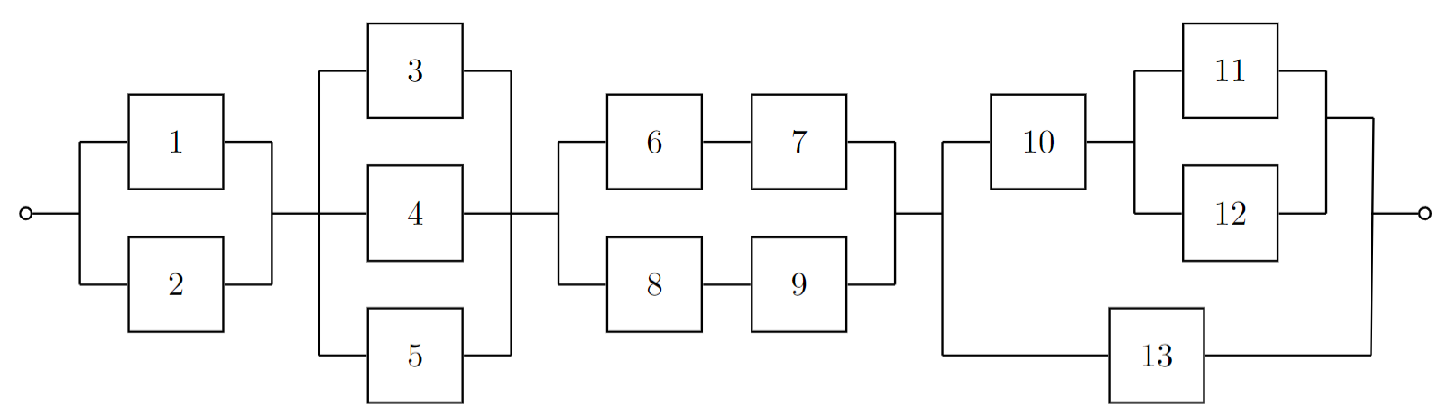
Complex Systems
Guo et al. (2010) consider the system as depicted but assume independence and don’t test subsystems

Slide 16
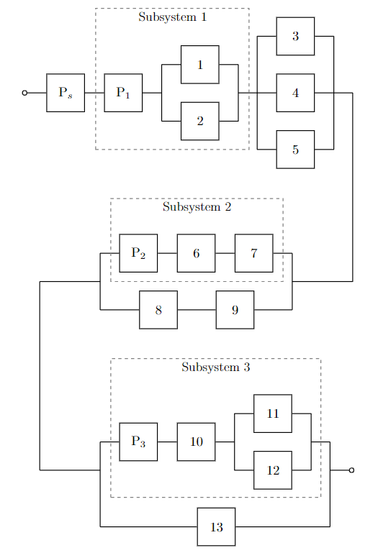
Complex Almost-Series and Almost-Parallel Systems
Modified version of Guo et al. (2010) system
Subsystems can be testable and provide useful information
A phantom component is added for the whole system and for each testable subsystem

Slide 17
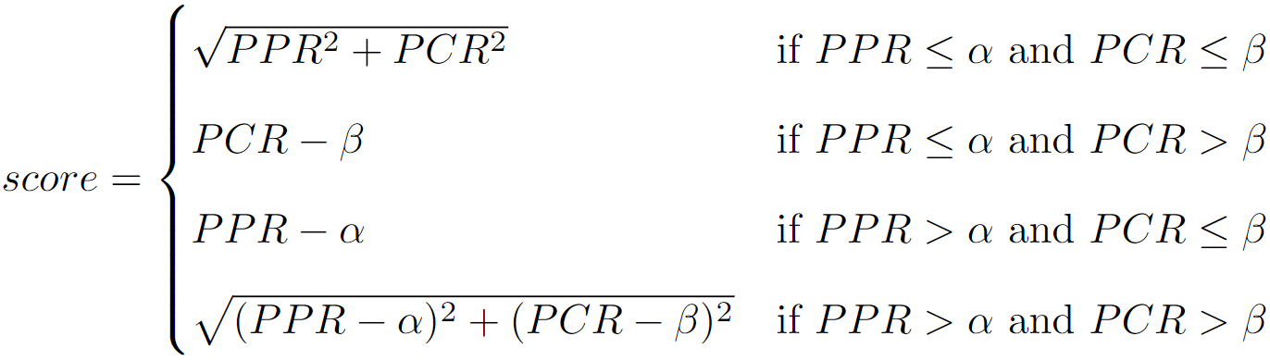
Comparing Different Tests
PPR
α
β
PCR

Slide 18

Overview of Algorithm to Find Test Plan
Find an acceptable test plan using only system tests
Remove one system test
Add a test to all components and repeat until we achieve an acceptable test plan
Remove individual component tests (most expensive first) while still maintaining acceptable PCR and PPR
Check the test is cheaper than the current iteration
Repeat start at step 2 until an acceptable and cheaper test can’t be found

Slide 19
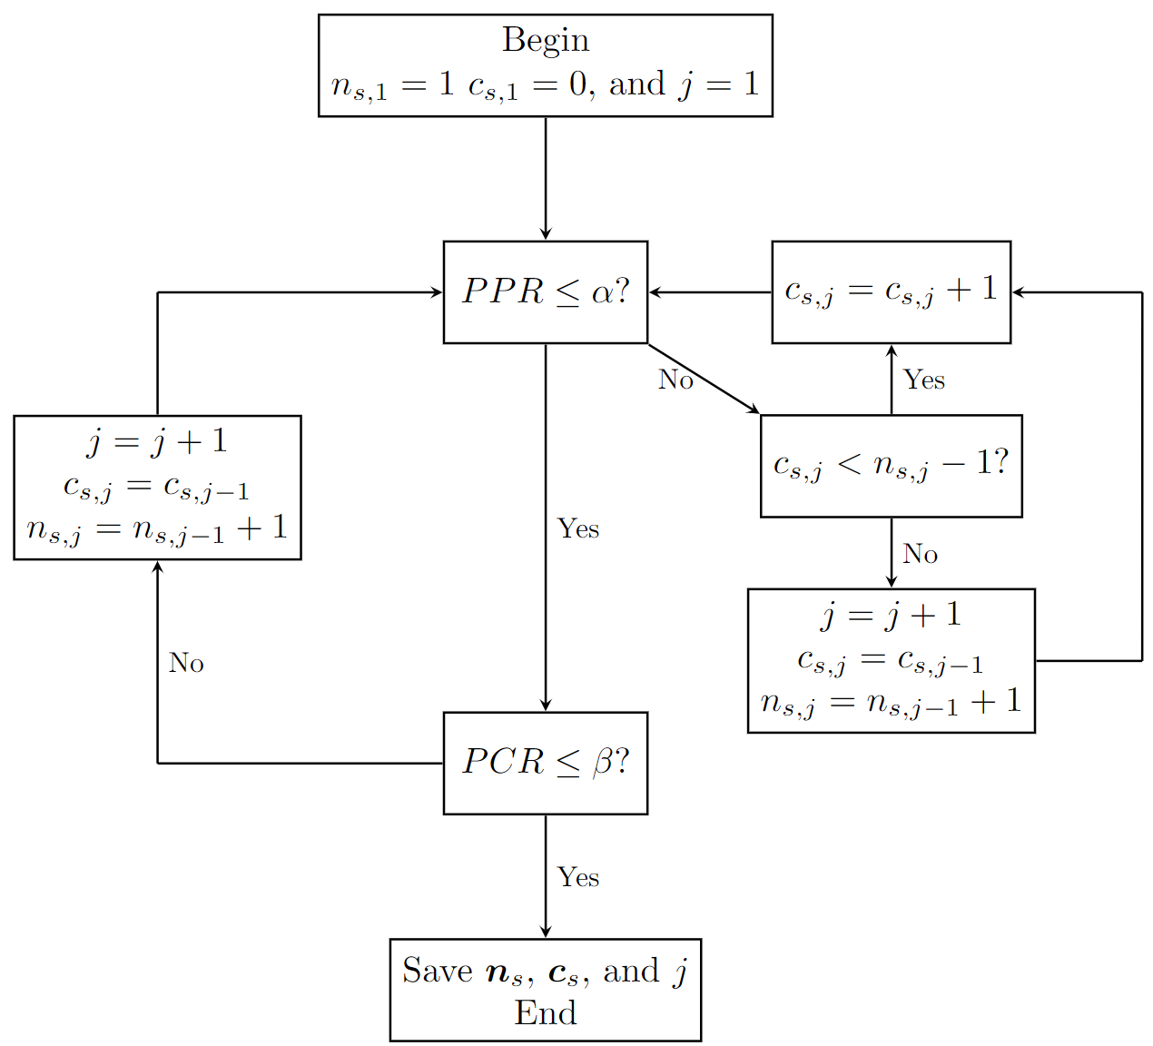
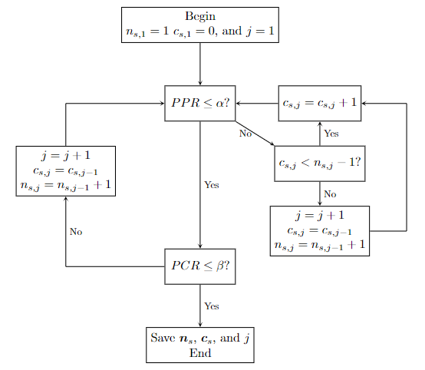
Modified Algorithm for System Tests
Hamada et al. (2008) provide the base for our algorithm
We adjust it by saving the values of n_{s} and c_{s} at every iteration
Doing so creates a framework for augmenting the system tests more efficiently

Slide 20
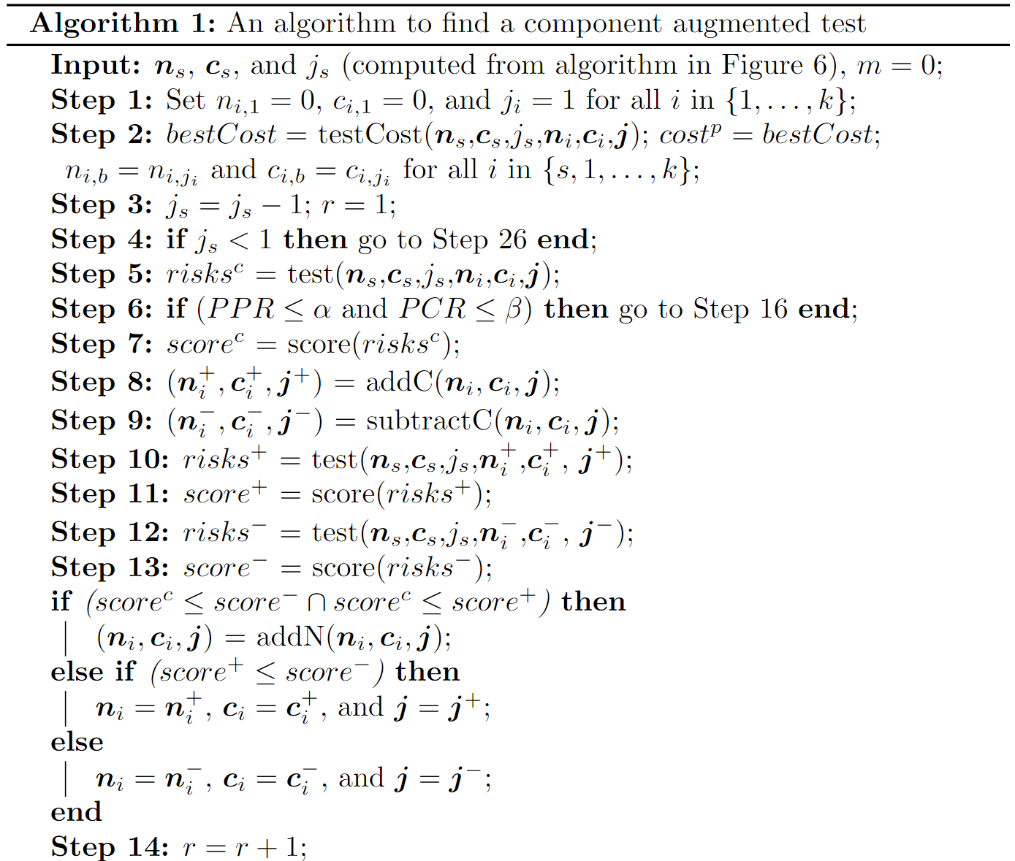
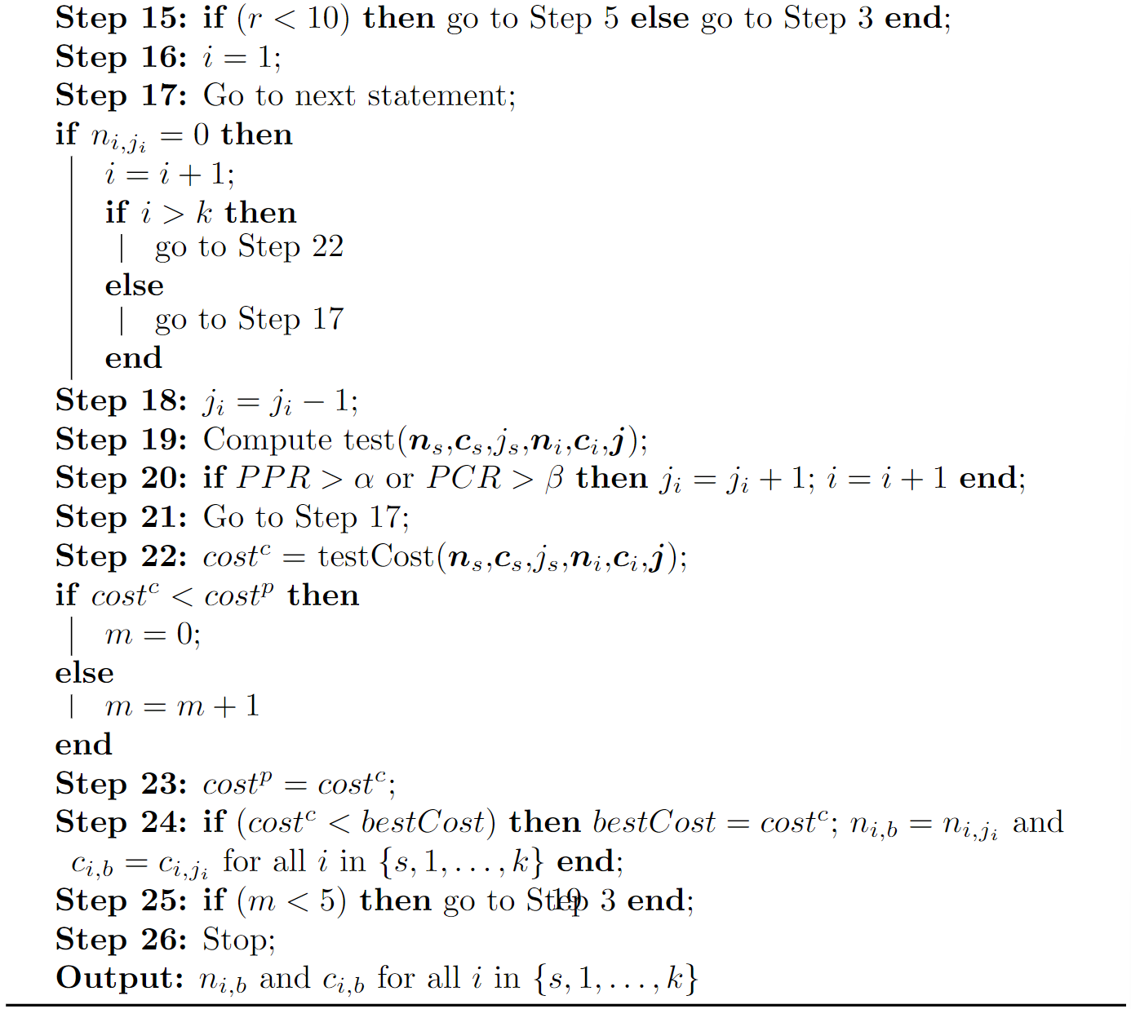
How to Augment System Tests

Slide 21
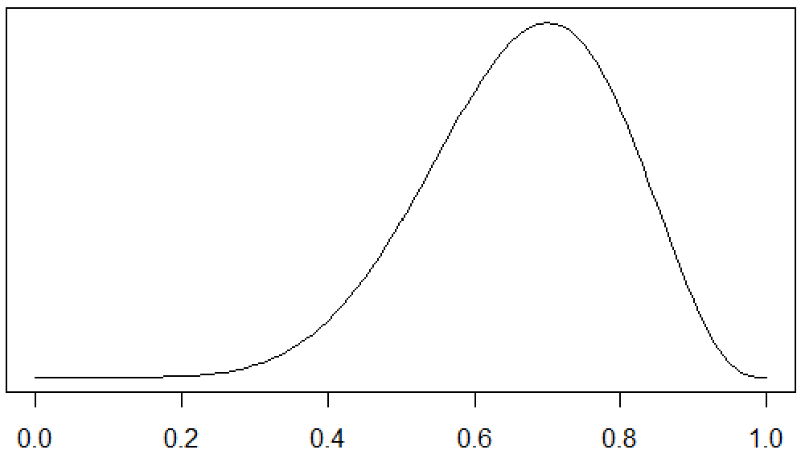
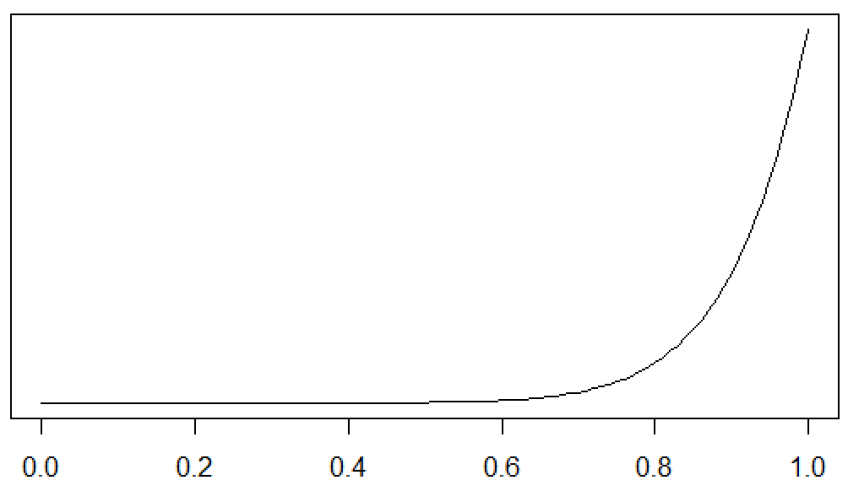
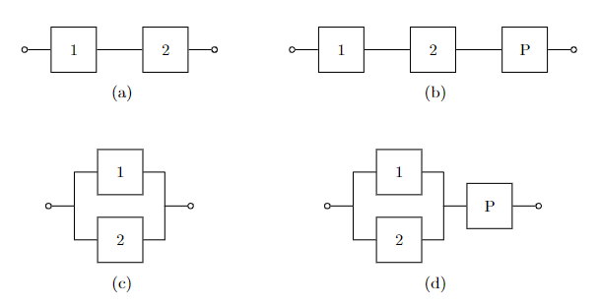

Simulation Study
We consider the four basic systems
All numbered components have beta(8,4) priors. Phantom components have beta(11,1) priors
We used these test conditions: α = β = 0.05, π_{arl} = 0.95, and π_{rrl} = 0.90
System tests cost 4 units and component tests cost 1 unit

Slide 22
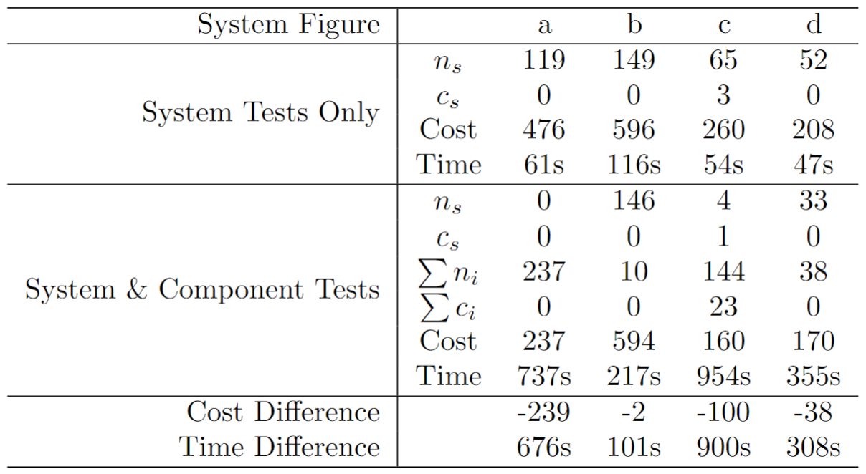
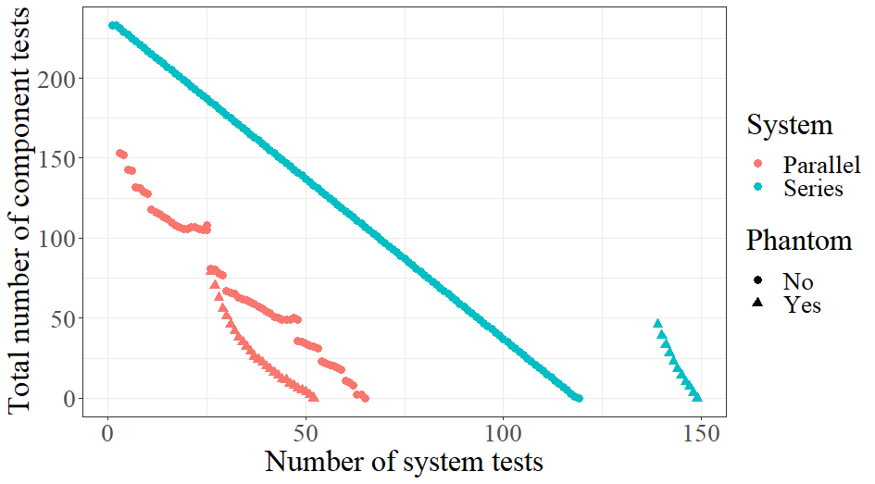
Simulation Results

Slide 23
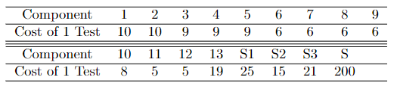
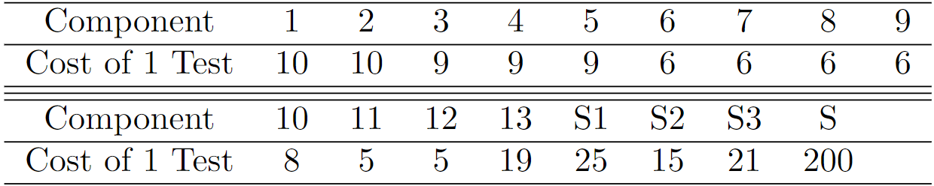
Application Setup

Slide 24
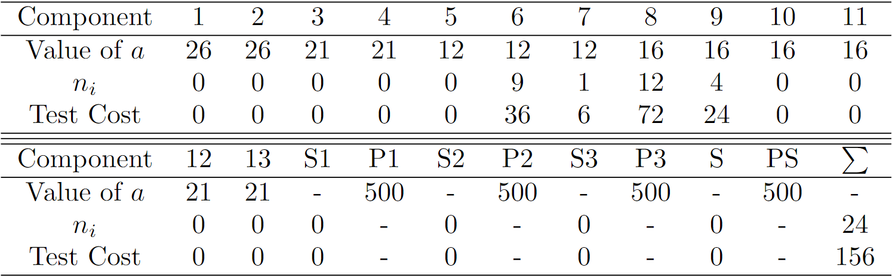
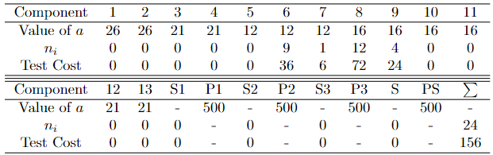
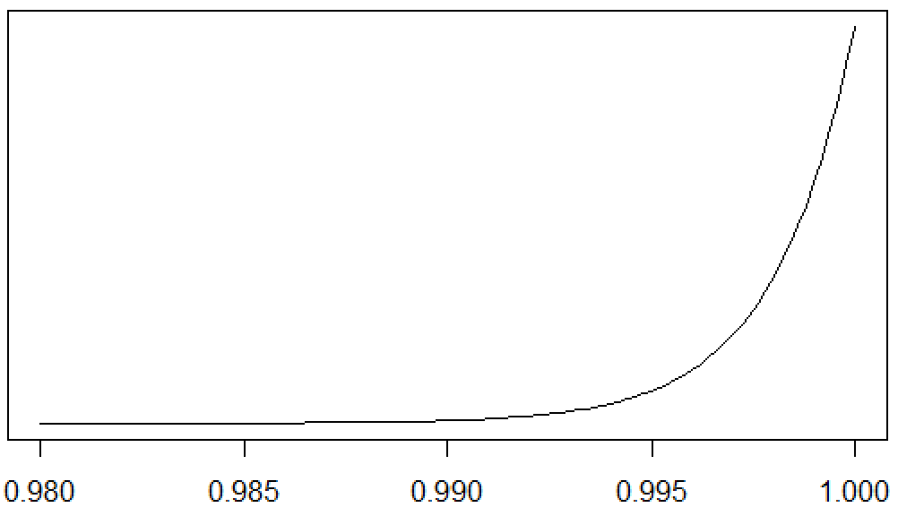
Application – Informative Priors no PPR
We compare our results with those from Hamada et. al. (2014) and don’t consider PPR (i.e., c_{s} = 0)
Each component had a beta(a,1) prior
Set β = 0.05, π_{rrl} = 0.95
They found a test with n_{s} = 7 and c_{s} = 0 (assuming independence) (test cost is 1400)
We started with a test with n_{s} = 13 and c_{s} = 0 (using phantom components) (test cost is 2600)
Using component test we get a test cost of 156 (cost reductions of 1244 and 2444 units respectively)

Slide 25
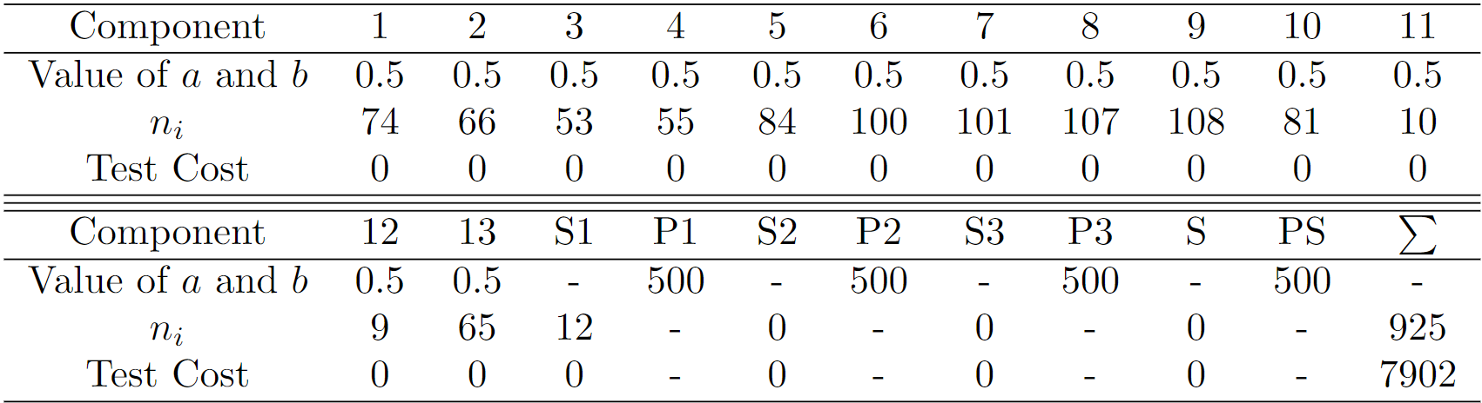
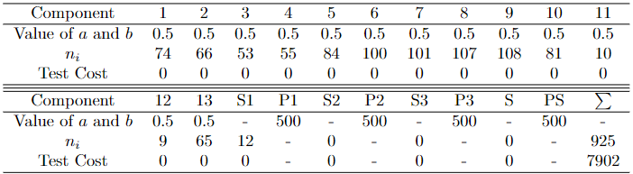
Application – Reference Priors & PPR
Here, we consider PPR. A lower cost test is found by using Jeffrey’s priors for testable components than informative priors
We started with a test with n_{s} = 108 and c_{s} = 0, where β = 0.05, π_{rrl} = 0.95, π_{arl} = 0.96, α = 0.05 (test cost of 21600)
Using component tests we obtain a cost of 7902 (a cost reduction of 13698 units)

Slide 26
Discussion
Replacing system tests with component tests is useful when controlling for PCR and PPR
Often, a cheaper test can be found that doesn’t fully rely on system tests
Applications can include testing reliability of cost inhibitive systems or systems that cannot be tested but whose components can
Future work could include finding a more optimized algorithm for augmenting system tests as well as considering systems whose reliability is not measured as pass/fail

Slide 27
Bibliography
Graves, T. L., Anderson-Cook, C. M., and Hamada, M. S. (2010). Reliability models for almost-series and almost-parallel systems. Technometrics, 52(2):160–171.
Guo, H., Jin, T., and Mettas, A. (2010). Designing reliability demonstration tests for one-shot systems under zero component failures. IEEE Transactions on Reliability, 60(1):286–294.
Hamada, M. S., Wilson, A., Reese, C. S., and Martz, H. (2008). Bayesian Reliability. Springer.
Hamada, M. S., Wilson, A. G., Weaver, B. P., Griffiths, R. W., and Martz, H. F. (2014). Bayesian binomial assurance tests for system reliability using component data. Journal of Quality Technology, 46(1):24–32.
Smith, C., Kelly, D., and Dezfuli, H. (2010). Probability informed testing for reliability assurance through Bayesian hypothesis methods. Reliability Engineering & System Safety, 95(4):361–368.
Ten, L. M. and Xie, M. (1998). Bayes reliability demonstration test plan for series-systems with binomial subsystem data. In Annual Reliability and Maintainability Symposium. 1998 Proceedings. International Symposium on Product Quality and Integrity, pages 241–246. IEEE.

Slide 28
Thank you!

